Slide 1
STUDENT ADMISSION PORTAL
Name: Pavan Kulkarni
USN: 1NH19CS409
Under the guidance of: Ms.Sooja Rani

Slide 2
OBJECTIVES OF THE COURSE
Some Features of Java : Simple ,Object Oriented , Portable, Platform independent, Secured, Robust, High Performance, Multithreaded, Distributed.
Object-oriented : Java is an object-oriented programming language. Everything in Java is an object. Object-oriented means we organize our software as a combination of different types of objects that incorporates both data and behavior.
1) Inheritance
2) Polymorphism
3) Abstraction
4) Encapsulation

Slide 3
ABSTRACT
Software is computer-based and can record plenty of data.
We can search, forecast, record any achieved task, etc. within no time.
This system helps the student as well as the administrative department of an organization for planning and execution of a task in a methodical manner
student details display ,register ,update etc. in the organization.

Slide 4
OBJECTIVES OF THE PROJECT
OBJECT :
1) An object is a self-contained entity that has a state, behavior and identity.
2) Object allocates memory for the template class. It defines the behavior of the class.
3) It is a specimen or instance of class used to invoke or execute any of the methods or features of the class for which object is created.
4) An object contains physical as well as logical entity whereas a class does not. place for a class when object is created.
Contd..

Slide 5
OBJECTIVES OF THE PROJECT
Inheritance
1) Inheritance is an oops concept in java that allows us to define a class from an existing class.
2) The keyword ‘extends’ is used for inheritance.
3) Superclass: The parent/base class from which attributes, methods are inherited.
4) Subclass: The child/derived class which inherits attributes, methods.
Contd..

Slide 6
OBJECTIVES OF THE PROJECT
EXCEPTION HANDLING
1) An exception is the error that occurs during the successful execution of a program. These errors need to be handled and this process is known as exception handling
2) Checked exception: These are the exceptions that arrive at the time of compilation, checked by compiler and needs to be handled by the user.
3) Unchecked exception: These are the errors that occur during execution process and are ignored by compiler because they occur due to logical errors, programming bugs or improper uses of APIs. These errors are known as runtime exceptions.

Slide 7
PROBLEM STATEMENT
Every year, students in thousands queue up for collecting admission / application forms and then again for submitting the admission / application forms. This leads to problems in managing the applications, resulting in annoyed parents and students alike.
Institute incurs expenditure on printing of admission forms, and in absence of any reliable forecasting system on how much application it is going to receive it may overspend by printing excessive application forms or may fall in crisis if there is excess demand of application forms.
Chances of form misplacement are very high, because of huge number of applications.
Wastage of institute's resources due to involvement of people / teachers in form collection.

Slide 8
FUNCTIONALITY
Admin Login System
Student Login System
Admin Dash Board : includes
1) Search
2) Update
3) View Records
Student Portal : includes
1) Register New Student
2) View Profile
3) Pay Fees
4) Edit Profile

Slide 9
DESIGN
ALGORITHM
Step 1: START
Step 2: Admin portal
Step 3: If credentials are valid: -
1.1 Search
1.2 Update
1.3 display student details
Contd..

Slide 10
DESIGN
Step 4: STUDENT PORTAL
4.1 Register
4.1.1 Enter Personal details
4.2 If Login Success.
4.2.1 Display Personal Details
4.2.2 Pay Fees
4.2.3 Check admission Status
4.2.4 Update Personal Details

Slide 11
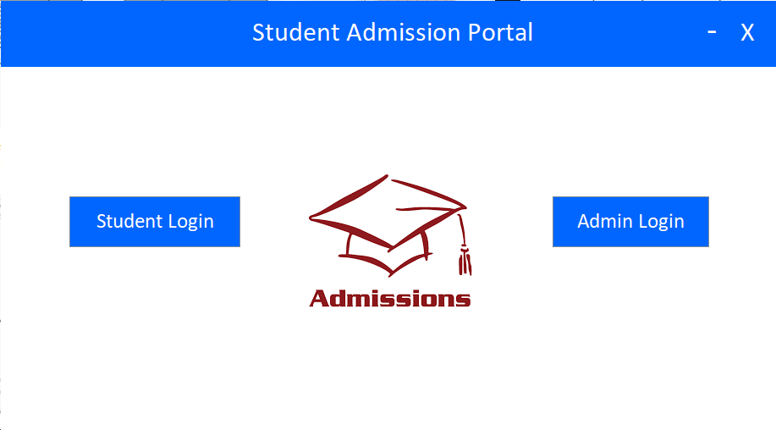
HOME

Slide 12
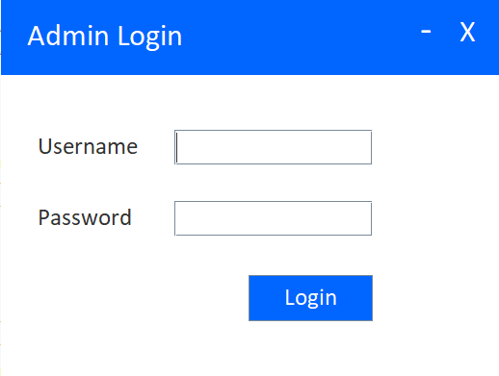
SAMPLE OUTPUT
Admin Login:

Slide 13
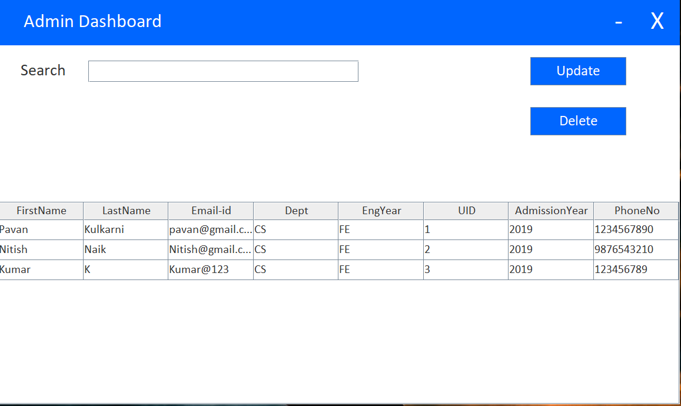
Admin Dashboard

Slide 14
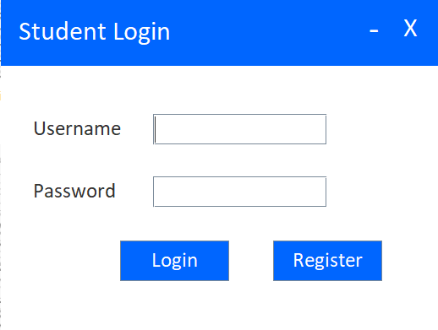
STUDENT LOGIN

Slide 15
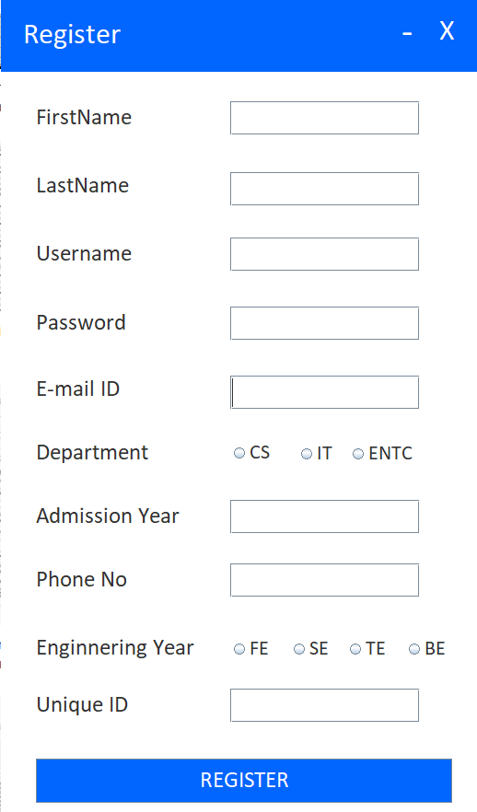
REGISTER NEW STUDENT

Slide 16
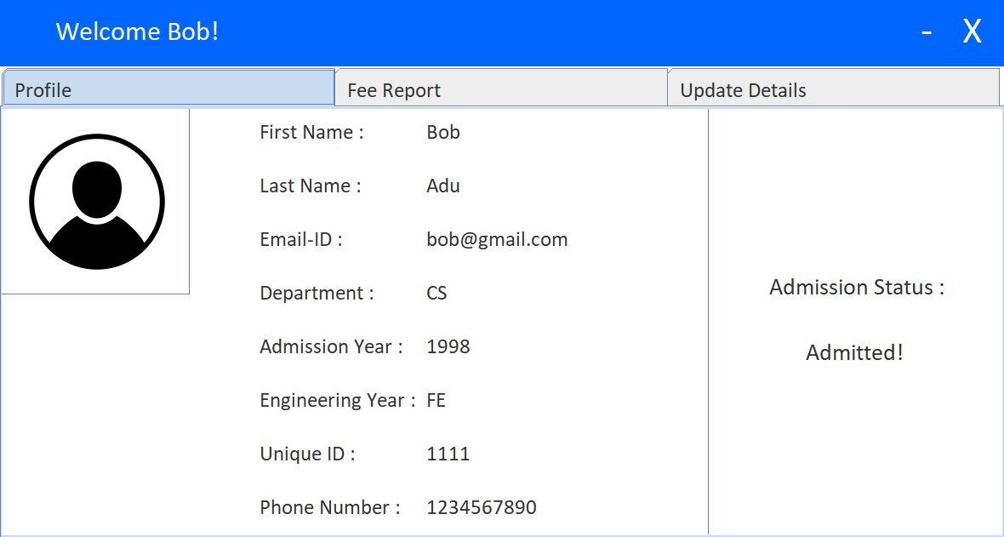
VIEW PROFILE

Slide 17
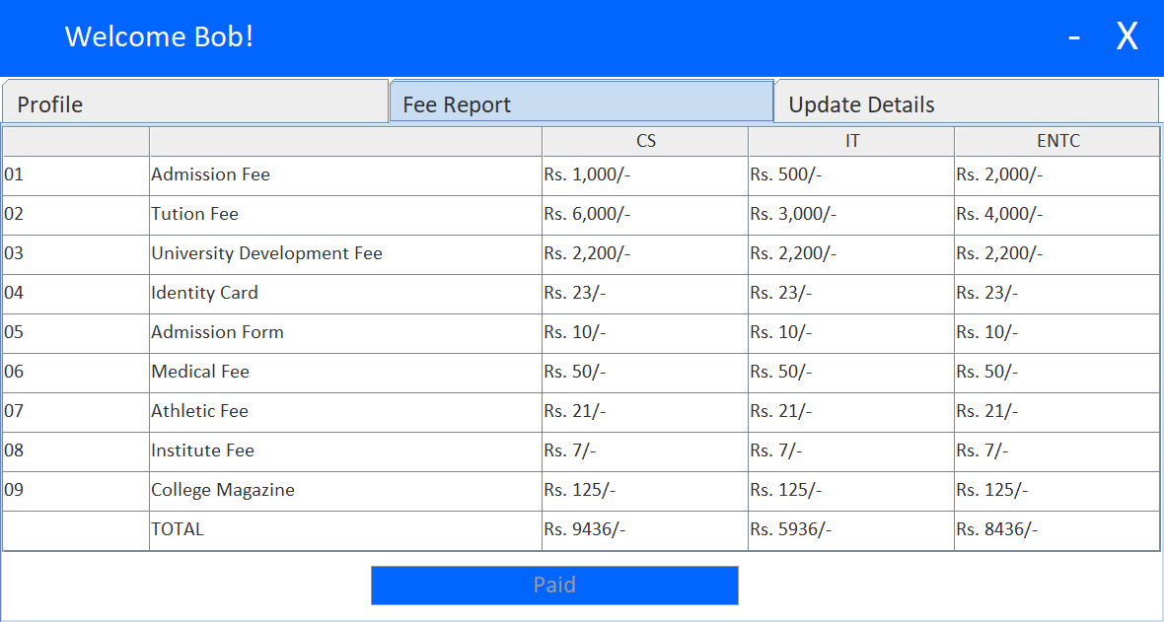
FEE REPORT

Slide 18
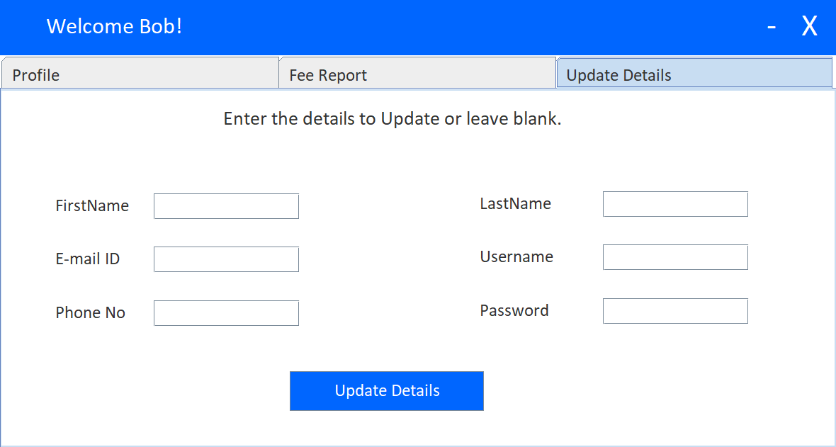
UPDATE DETAILS

